Slide 1

University of Massachusetts Lowell Master of Science in Business Analytics Capstone Project, Fall 2023
Enterprise Bank Data Architecture Transformation
Enterprise Bank Project Sponsors:
Hicham Naciri, Carolyn Mansour, Eric Pearson, Michael Angell, Karen Merrill
Manning School of Business Faculty Advisor:
Dr. Luvai Motiwalla, Dr. Amit Deokar
Team Members:
Andrew Mejia, Ashika Fnu, Ajay Kumar Bolla
Manning School of Business
MIST.6490 MSBA Capstone Projects, Professor Motiwalla, Spring, 2023 Slide 1

Slide 2

Project Background & Goals
Enterprise Bank:
Enterprise Bank was established in 1989 and headquartered in Lowell, Massachusetts and specializes in financial services such as checking accounts, loans, and mobile banking.
Project Overview:
Enterprise Bank is creating a Core Banking and API/Middleware roadmap to unlock functionality, remove dependency on a single vendor and build a core agnostic platform that will streamline operations, improve data quality and lead to improved customer journeys. This project is an exploratory phase to gather insightful information on various API/Managed Service vendors, solutions to manage the Middleware layer and Fiserv’s Communicator Open solution.
Objectives and Goals:
Analyze Enterprise Bank’s data architecture.
Perform Gap Analysis on current integrations vs Communicator Open from Fiserv.
Uncover managed service partners, middleware solutions and various approaches for building an API Strategy/Middleware platform.
Phase Approach:
Phase 1: Interview banks & vendors.
Phase 2: Extract & document insights from interviews.
Phase 3: Conduct Gap Analysis between Deposit Account Opening solution and Fiserv Communicator Open.
Phase 4: Deliver presentations to Enterprise Bank on the above.
Manning School of Business
MIST.6490 MSBA Capstone Projects, Professor Motiwalla, Spring, 2023 Slide 2

Slide 3
FISERV Communicator Open
Fiserv's Communicator Open streamlines integration for financial institutions with Fiserv platforms, enabling customization of technology ecosystems, easy access to third-party fintech, and support for open finance strategies.
Features & Functionality:
Normalized APIs.
Sophisticated Technologies.
Industry-Specific Services and Standards.
Scalability & Capability.
Value add to Banking Infrastructure:
Integration of Third-Party Innovations.
Enhanced Digital Experiences.
Real-Time Analytics and Streamlined Processes.
Extending IT Asset Value.
Cost-Effectiveness.
Manning School of Business
MIST.6490 MSBA Capstone Projects, Professor Motiwalla, Spring, 2023 Slide 3

Slide 4
VENDOR OVERVIEW: SOLUTION VENDORS
Solution Vendors Overview:
Solution vendors play a crucial role in delivering integrated solutions, focusing specifically on integration projects within the banking technology sector.
Vendor Highlights:
API PEOPLE:
Specialization: Renowned for their expertise in API managed services, with specialization in Fiserv Premier and middleware solutions.
Focus Area: Concentrates on integrating diverse banking systems.
Notable Achievement: Received excellent feedback from Banc of California for their services.
PORTX:
Specialization: Known for their proficiency in API managed services and middleware integration.
Focus Area: Primarily caters to the specific needs of financial institutions.
Manning School of Business
MIST.6490 MSBA Capstone Projects, Professor Motiwalla, Spring, 2023 Slide 4

Slide 5
VENDOR OVERVIEW: API / MIDDLEWARE VENDORS
API / Middleware Vendors Overview:
API/Middleware vendors are key players in offering the necessary tools and platforms to facilitate and manage the data exchange between different banking systems.
Vendor Highlights:
Denodo / Fiserv Open Data:
Offers a data virtualization platform, streamlining data integration and management processes.
MuleSoft:
Provides an additional abstraction layer in API architecture, enhancing the efficiency and maintenance API integrations.
JIFFY.AI:
Specializes in automation solutions, leveraging AI and machine learning to boost middleware functionalities.
Manning School of Business
MIST.6490 MSBA Capstone Projects, Professor Motiwalla, Spring, 2023 Slide 5

Slide 6
Insights and Recommendations from interviews with bank
Insights:
Bank of Tampa (BoT):
Initially sought more autonomy from Fiserv.
Valued Communicator Open.
Partnered with Clarim and MuleSoft.
Banc of California:
Needed cloud-compatible solutions, leading to the adoption of Communicator Open.
Appreciated the shift from SOAP to RESTful APIs.
Overcame initial integration challenges by partnering with API People.
Recommendations:
Bank of Tampa (BoT):
Consider independent integrators like Clarim.
Invest in robust middleware solutions like MuleSoft.
Leverage Communicator Open.
Banc of California:
Embrace the RESTful nature of Communicator Open.
Partner with API People to overcome integration challenges.
Implement robust security and governance measures.
Manning School of Business
MIST.6490 MSBA Capstone Projects, Professor Motiwalla, Spring, 2023 Slide 6

Slide 7
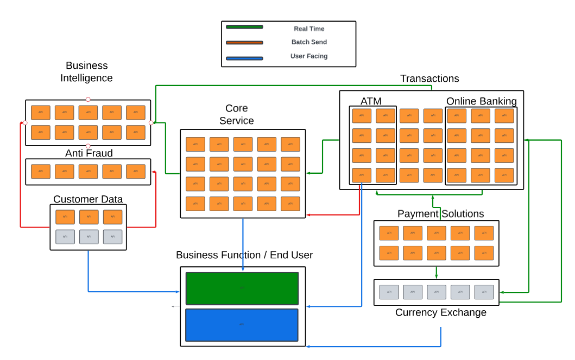
Gap Analysis: Micro-Service Data Architecture
Manning School of Business
MIST.6490 MSBA Capstone Projects, Professor Motiwalla, Spring, 2023 Slide 7

Slide 8
Communicator Open Gap Analysis
Fiserv Communicator Open Value Proposition:
Enhanced Integration: Smooth connectivity with financial networks and services.
Improved Customer Experience: User-friendly interfaces and engagement tools.
Advanced Security: Superior protection of sensitive financial data.
Scalability and Flexibility: Easily adaptable to growth and market changes.
Cost-Effectiveness: Long-term savings through efficiency and lower maintenance.
Compliance Ease: Tailored to meet banking regulatory requirements.
Real-Time Processing & Analytics: For better decision-making and personalized services.
Innovative Offerings: Enables offering of modern financial products and services.
Manning School of Business
MIST.6490 MSBA Capstone Projects, Professor Motiwalla, Spring, 2023 Slide 8

Slide 9
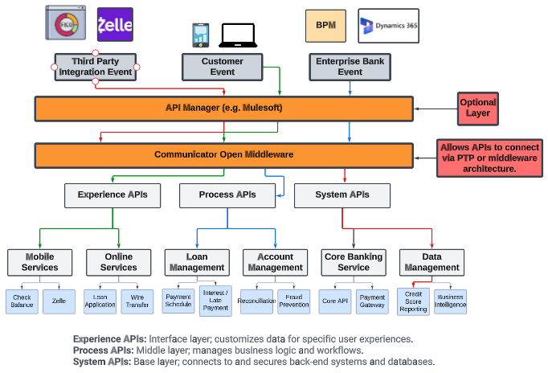
Gap Analysis: Middleware led Data Architecture
Manning School of Business
MIST.6490 MSBA Capstone Projects, Professor Motiwalla, Spring, 2023 Slide 9

Slide 10
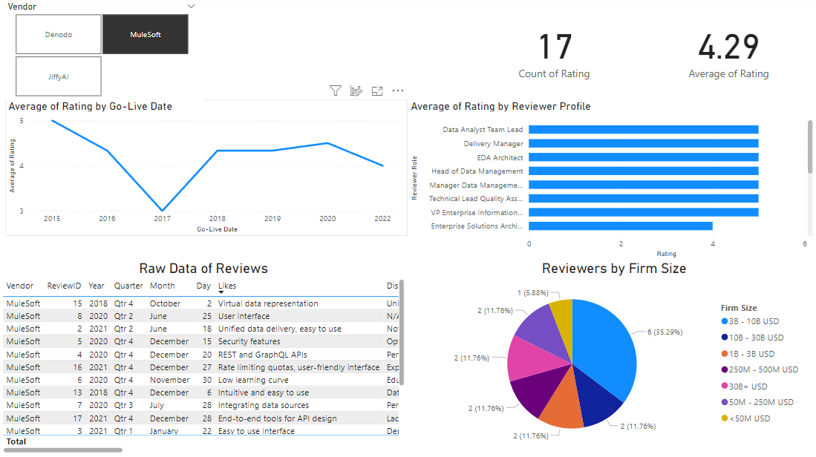
Vendor Evaluation Dashboard
Manning School of Business
MIST.6490 MSBA Capstone Projects, Professor Motiwalla, Spring, 2023 Slide 10

Slide 11
Conclusion
Conclusion:
Overall, this project served as an exploratory phase of building an API/Middleware strategy that will allow the bank to build a middleware platform that will allow the bank to remove dependency on a single vendor and build improved customer journeys. This assisted the bank to identify and summarize API/Middleware partners, middleware solutions and approaches for building a core agnostic middleware platform that will allow the bank to be nimble and enable engagement with other Fintech providers into the future.
Key Highlights:
MuleSoft and API People stood out compared to the rest of the vendors.
A combination of vendors should be considered. No silver bullet.
Collaboration with other banks helps identify approaches and lessons learned.
Going forward:
There other constraints the team will need to consider after our project is concluded:
Cost
Engineers
Timeline
Manning School of Business
MIST.6490 MSBA Capstone Projects, Professor Motiwalla, Spring, 2023 Slide 11

Slide 12
University of Massachusetts Lowell Master of Science in Business Analytics Capstone Project, Fall 2023
Thank you!
See you at our poster session!
Manning School of Business
MIST.6490 MSBA Capstone Projects, Professor Motiwalla, Spring, 2023 Slide 12

